Slide 1
WEB, MOBILITY, RPA & BI
Capabilities & Offerings
July 2021
Copyright ©2021. All rights reserved

Slide 2
Submitted By
Profile
Prepared By
Date: 06-July-2021
Version: 5.0
Jeyakumar SS
Contact
Approved By
Anand Kalidass | CEO
25, Ganesh Avenue, Pallikaranai, Chennai 600 100
corp@kaladi.in | www.kaladi.net

Slide 3
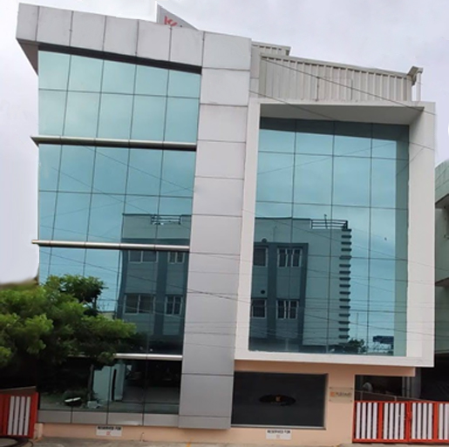
Summary
Kāladi Consulting Services (“Kāladi”) is an eight years old, Chennai, India based Enterprise Solutions company, specializing in providing IT solution consulting & services to enterprises across domains and geographies.
Our offerings span Enterprise (ERP), Web and Mobility technology solutions.
We are an Oracle Partner, Oracle NetSuite Solutions Partner, and our resource base has widespread capabilities and skills in Oracle EBS R12, Oracle Fusion Cloud, Oracle NetSuite, Web, Mobile Technologies (Android & iOS), Analytics and Automation (RPA). Our consulting team of over 80 professionals includes business analysts, domain specialists and technical professionals with deep experience in their respective areas.
Our customers are in India, West Africa, Middle East, Singapore, Europe, USA and Canada. Our robust delivery processes help us meet our customer expectations with timely, quality deliverables.
We have IPs in Enterprise Procurement (Kprocure), Sales force automation (Ksfa) and Enterprise fleet management (Kfleet). We also have our eCommerce platform, Kmarket to cater to B2C and market place needs.

Slide 4
About
ERP (on premise & cloud)
Web
Mobility
Analytics
Automation (RPA)
OFFERINGS
CORE EXPERTISE
Distribution & Retail
Manufacturing
Oil & Gas; Energy
BFSI
CUSTOMERS
India, Middle east & Africa, Singapore. Europe, USA
8years | 90+ employees
IT consulting, solutions and services
Value Added Solutions
(IPs)
To be the preferred Enterprise Technology Solutions & Services Partner.
Deliver Solutions & Services of superior quality by leveraging state of the art technologies & best practices.
Customer Focus
Integrity
Accountability
Result Orientation Empowerment.
PARTNERS
Excellent
Infrastructure

Slide 5
Our Journey
Declared an independent Practice for Web & Mobility
Added BI & RPA to delivery
Declared an independent Practice for BI & RPA
Added Sales team for Web & Mobility
Added Documentation team
Added UI/UX practice
Team of 2 for Group Web development needs
2015
2018
2019
2020
Added Mobility team
Initiated Ksfa SI Solution
Added MS Dynamics
Created a set of IP Solution (Ksfa, Kprocure, Kmarket)
Implemented KQMS practice
Implemented L&D practice

Slide 6
Capabilities and Offerings
Technology Coverage
MOBILITY
Angular
.Net
PHP
Node JS
HTML + CSS
Android Native
Java Script
IONIC – Hybrid
React JS – Hybrid
MySQL
SQL Server
Oracle
SQLite
Development
Website
OFFERINGS
Support Service
WEB
ANALYTICS
Maintenance Support
IP Solution Rollout
Tools Coverage
Tableau
Power BI
Apache Superset
Automation Anywhere (AA)
WordPress
Robocorp
Tensorflow
Implementation
AUTOMATION

Slide 7
Domain Experience
Manufacturing
Distribution
Food and FMCG
Oil and Gas
Pharmaceuticals
Products
Health Care
Education
Life Science
Retail + POS

Slide 8
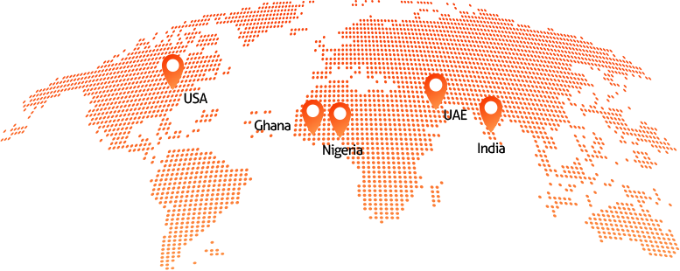
Geo Experience

Slide 9
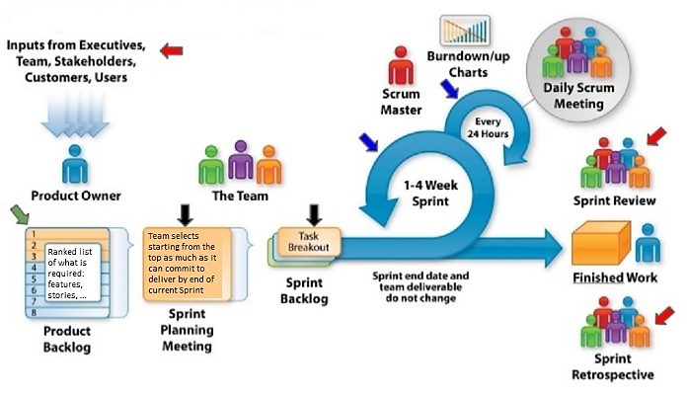
Implementation Methodology (Agile)
Contact

Slide 10
Customers
Customer Name | Industry | Location | Engagement | Duration
Fareast Mercantile Company Limited | Food, FMCG, Appliances Distribution Appliance Assembly Soap Manufacturing Food and FMCG Items Repacking | Nigeria Ghana Dubai | Tableau, Desktop Gadgets, Van Tracker, Document Management System, Ordering App, Merchandizing App | Since 2013
Worldwide Healthcare Limited | Pharma Distribution | Nigeria Ghana Dubai | Tableau, Desktop Gadgets, Won Sales Tracker | Since 2013
Africa Lifestyle | Retail | Nigeria | MS Dynamics Nav, LS Retail | Since 2018
Emzor Pharmaceuticals Limited | Pharma Manufacturing and Distribution Medical Equipment Distributions | Nigeria | KSFA Implementation | Since 2019
Apple&Pears | Pharma Distribution | Nigeria | KSFA Implementation | 2019 -2020
Proficio | Life Science | US | IOS Custom Mobile App | 2018-2019

Slide 11
Customers (Contd.)
Customer Name | Industry | Location | Engagement | Duration
Emzor Pharmaceuticals Limited | Pharma Manufacturing and Distribution Medical Equipment Distributions | Nigeria | RPA Implementation (Automation Anywhere) | Since 2019
Tata Power SED | Manufacturing | India | Custom Web Solution | Since 2019
Pl Algro Technologies Ltd | Farming Products | India | Custom Web Solution | Since 2020
DTEA | Education | India | Custom Web Solution | Since 2020
Vista Africa | Life Science | Africa | KSFA Implementation | Since 2020
Evans Baroque | Health Care | Africa | KSFA Implementation | Since 2020
Acrologic | Medical Billing Wholesalers | India/US | RPA Implementation (Automation Anywhere) | Since 2021

Slide 12
Web, Mobility, & BI Customer
Modules
Desktop Gadgets
Ordering app
Merchandizer
Document Management
Van tracker
Stock tracker
Sales tracker
Started with Nigeria Operations, we implemented web solution for their Ghana Operations as well
We are not just Consultants for them, but also have doing Business Process Consultants across their business operations
The customer implemented Custom web solution in 2013. We continue to manage their web related solutions since then
Fareast Mercantile
Leading FMCG Distributor in Ghana, Nigeria

Slide 13
Web & BI Customer
We are not just Consultants for them, but also have doing Business Process Consultants across their business operations
Started with Nigeria Operations, we implemented web solution for their Ghana Operations as well
Modules
Desktop Gadget
Manager App
Principal App
Won
Van tracker
Sales Tracker
The customer implemented Custom web solution in 2013. We continue to manage their web related solutions since then
Worldwide Healthcare
Leading Pharma Distributor in Ghana, Nigeria

Slide 14
Ksfa Customer
The customer had faced the difficulties in managing their Sales process and it leads to drop in sales on more consumption of Time in manual works, To replace the manual work & to save their time & to increase the sales and positioning the Customer in market with high efficiency & honor.
Modules
Order Management
Secondary Sales Management
Payment Collection Management
Employee Expense Management
Product Management
Stock Management
SR Activity and Tracking Management
Journey plan management
E- Detailing Management
Geo-Fencing Management
Easy Integration to Any ERP
Gone Live by May 2019.
We continue to support the customer for the Sfa Operations
About 200+ SR are using our Ksfa application which is integrated to Oracle fusion Cloud
Emzor Pharmaceuticals
Leading Pharma Manufacturer and Distributor in Nigeria

Slide 15
Ksfa Customer (Contd.)
Modules
Order Management
Secondary Sales Management
Payment Collection Management
Employee Expense Management
Product Management
Stock Management
SR Activity and Tracking Management
Journey plan management
E- Detailing Management
Geo-Fencing Management
Easy Integration to Any ERP
About 50+ SR are using our Ksfa application
Gone Live by Jan 2020
We had implanted our Ksfa Solution to Increase the Growth of the Business
Apple & Pears
Pharma Distributor in Nigeria

Slide 16
Ksfa Customer (Contd.)
Modules
Order Management
Secondary Sales Management
Payment Collection Management
Employee Expense Management
Product Management
Stock Management
SR Activity and Tracking Management
Journey plan management
E- Detailing Management
Geo-Fencing Management
Easy Integration to Any ERP
About 30+SR are using our Ksfa application which is integrated to SAP
Gone Live by Nov 2020.
We continue to support the customer for the SFA Operations
We had implanted our Ksfa Solution to Increase the Growth of the Business
Vista Africa
Life science in Nigeria

Slide 17
Ksfa Customer (Contd.)
Modules
Order Management
Secondary Sales Management
Payment Collection Management
Employee Expense Management
Product Management
Stock Management
SR Activity and Tracking Management
Journey plan management
E- Detailing Management
Geo-Fencing Management
Easy Integration to Any ERP
About 75+SR are using our Ksfa application which is integrated to Tally
Gone Live by Apr 2021.
We continue to support the customer for the SFA Operations
We had implanted our Ksfa Solution to Increase the Growth of the Business
Evans Baroque
Health Care in Nigeria

Slide 18
Web Solution Customer
About 100+ users, 3000+ customers are registered in the Application
Gone Live by Nov 2020.
We continue to support the customer for the Operations
Modules
User Management
RFQ
PO Tracking
Product Details
Audit
DCC
Customer Quote
The customer had limitations in the procurement area, we had implemented our Kprocure solution
TATA POWER SED
Leading Manufacturer in India

Slide 19
Mobility Customer
This was the first IOS Implementation in the US market
Modules
Visitor tracking
Metrics
Audit log
Email
Gone Live by Mar 2018
The customer had problem in maintaining the customer data, we provide a solution to capture the visitor details in iOS Mobile app
Proficio
Life Science, US

Slide 20
Web Portal Customer
We continue to manage their website.
Modules
DTEA Alumni Trust
DTEA Schools
Regd. Alumni Search
News Letter
Alumni Achievers
Gallery
Contact Us
Gone Live by Dec 2018
We developed a web portal for DTEA Alumni students.
DTEA Alumni Trust
Education, India

Slide 21
Web Portal Customer (Contd.)
We continue to manage their website.
Modules
About
Product Category
Contact
Gone Live by Mar 2021
We developed a web portal for organic manure products.
PL Agro Technologies Limited
Manufacturer of organic manure & specialty fertilizers in India

Slide 22
LS Retail Customer
Modules we are supporting
Finance (AP, AR, GL, Cash Management)
Inventory
Backoffice
Store POS
We continue to manage their Retail Business.
Supporting since Oct 2019
Kāladi has supported ALS on support & implementing various Customization to meet the need of the Business
Africa Lifestyle Limited
Leading Cosmetics Retailer in Africa Region

Slide 23
RPA Customer
Modules we are supporting
Finance (AP, AR, GL, Cash Management)
Inventory
Backoffice
Order Management
Gone live by Apr 2019. Supporting since May 2019.
We continue to manage their Business.
Kāladi provided an end-to-end solution to automate Emzor’s entire business process with MDS (Pharma Logistics Partner).
Using the task bots and other tools in Automation Anywhere, Emzor’s users are able to automate ERP process (Stock Transfers & Account Receivables operations) and generate reports for MIS in Oracle Fusion.
Emzor Pharmaceuticals
Leading Pharma Manufacturer and Distributor in Nigeria

Slide 24
RPA Customer (Contd.)
Modules we are Implemented and Support
File download for different windows client application and web application
Save downloaded files in respective file paths
We continued support to manage their Business.
Implementing & Supporting since Feb 2021
Kāladi has supported MBW on support & implementing various Automation process to meet the need of the Business
Medical Billing Wholesalers
Leading provider of offshore medical billing, coding, and accounts receivable services to medical billing companies in US

Slide 25
Our Resources
By Skill
By Experience Years
We are a talented team of over 20 professionals with experience in enterprise solution architecting, designing, application development, testing, maintenance and support.
We have the ability to quickly scale and provide the requisite resources for our customer needs.
Our resources have deep skills in Web and Mobile Development

Slide 26
Thank You
Contact
25, Ganesh Avenue, Jeyakumar SS
Pallikaranai, VP & Head- (NetSuite, Web, Mobility)
Chennai – 600 100. ss.jeyakumar@kaladi.in
email: corp@kaladi.in Mobile : +91 9944940723
Web: www.kaladi.in
Copyright ©2021. All rights reserved

